Slide 1
Color Correction for Optical See-Through Displays Using Display Color Profiles
Srikanth Kirshnamachari Sridharan
Dr. Juan David Hincapié-Ramos
Dr. David R. Flatla
Dr. Pourang Irani
Notes:
Good morning
I am Srikanth K Sridharan,
Today I am presenting ,y Master’s thesis Proposal, titled “Solutions To The Colour Mixing Problem Present In See-Through Displays”
Supervised by Dr.Pourang Irani & Co-Supervisor Dr. Juan David Hincapié-Ramos.
I thank you all to be present today for this talk.

Slide 2
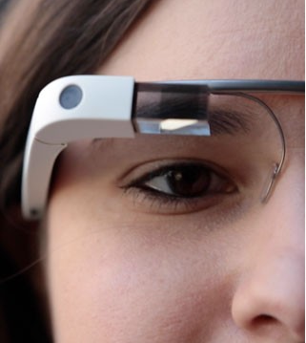
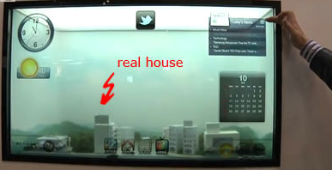
Introduction
Optical see-through displays (OSTD) allow users to view digital content and physical objects simultaneously.
Additive OSTD: Has its own light source
Subtractive OSTD: Filter external light source
Notes:
OSTD are of 2 types
Additive & Subtractive
Advantage of having its own light source enables Additive OSTD to have Hardware's of different form factors such as mobiles, HMD, window based displays!

Slide 3
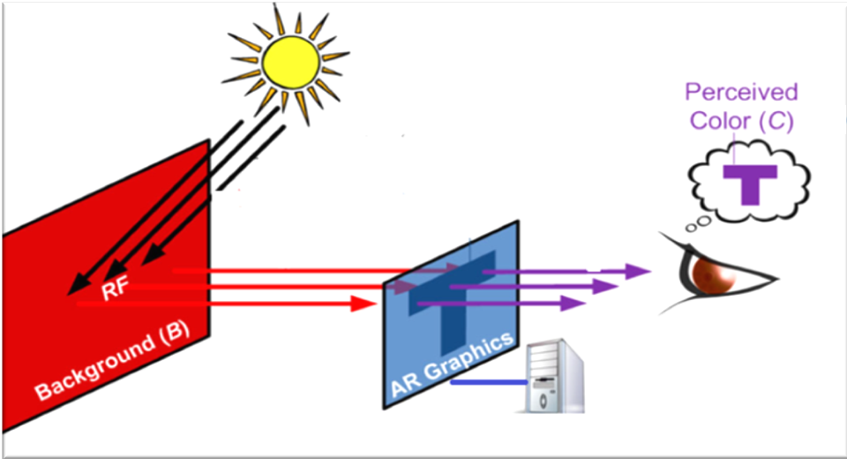
Gabbard et al - More than meets the eye: An engineering study to empirically examine the blending of real and virtual color spaces , VR 2010
Real world background color affects the displayed contents on the digital display
Notes:
However additive OSTD has a problem!
The real world background color belnds with the displayed color.
Color are essential to clarity of the display, colors help humans to clearly understand the contents on the display.
How ever this basic need for a display becomes a challenge with see-through displays, as the content on the screen always affected by the physical background.
This phenomenon cause the users perception of the color being displayed to changes from what the color originally is !

Slide 4
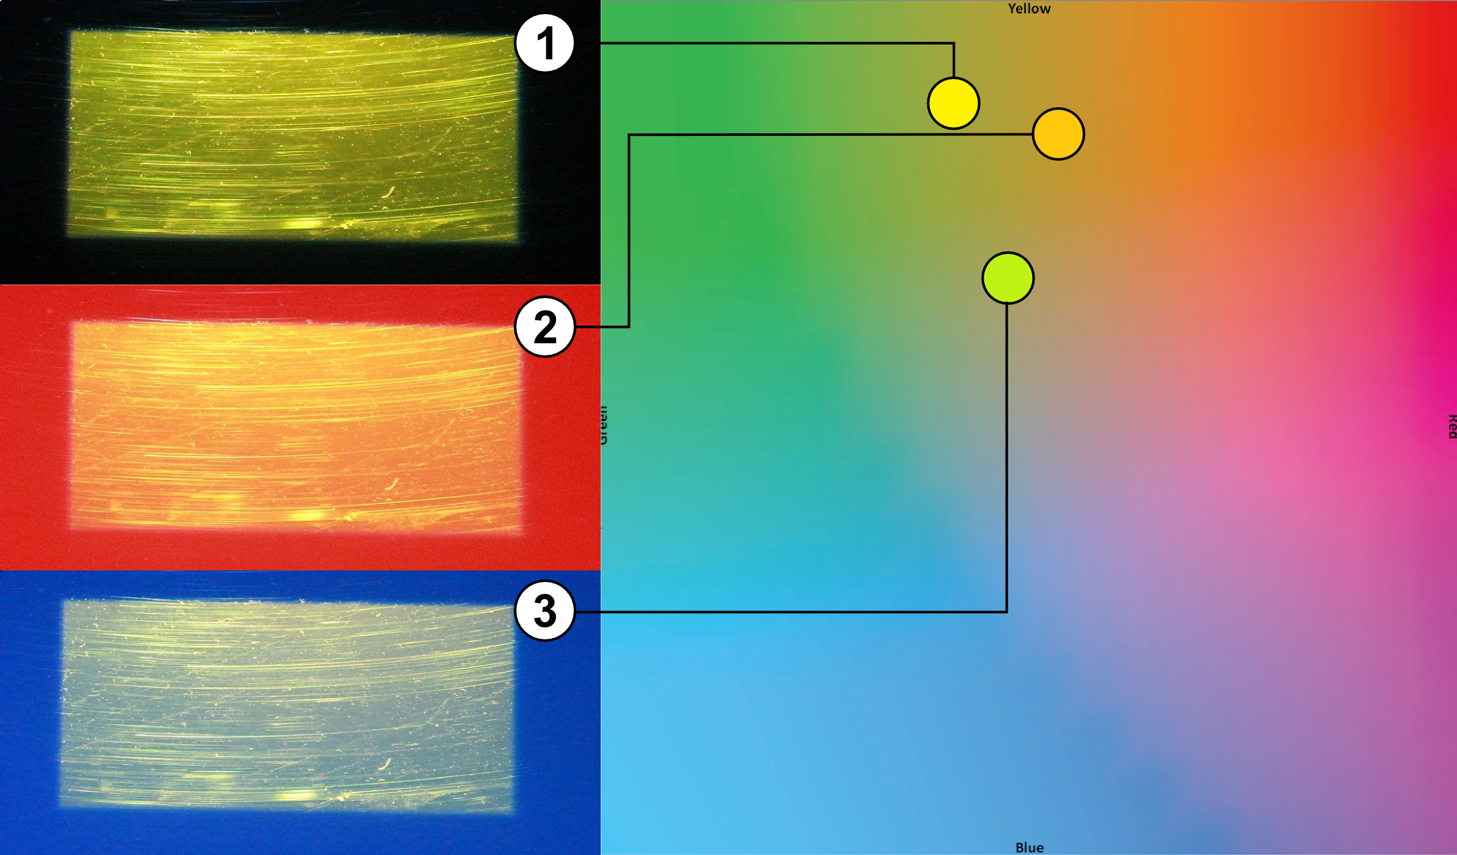
Notes:
So the Problem statement I will be working with is :..

Slide 5
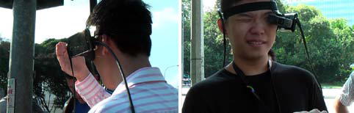
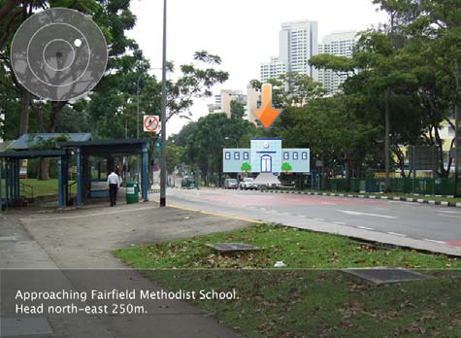
Usability Problem
Kerr et al :Wearable mobile augmented reality: evaluating outdoor
user experience. VRCAI ’11
Notes:
This efforts of background has been studied before by various researchers mostly in the field of Augmented reality.
Steven et al 2011, studies outdoor use of AR system, where they found on heavy influence from the background users used their hand on have a consistent bg to look at the contents !!
Kohei et al 2008, designed a system which shifts the content of a AR system as the background’s color was causing contrast issue.
This shows that this influence of the background is a significant problem

Slide 6
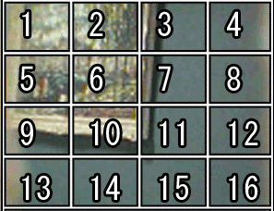
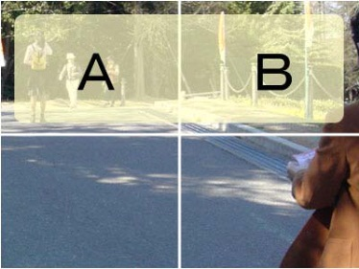
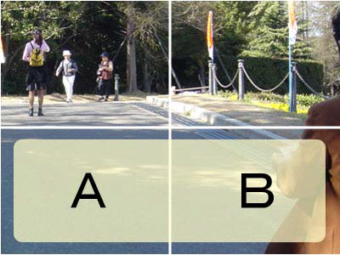
Content Based Solutions
Tanaka et al, An information layout method for an optical see-through head mounted display focusing on the view ability. ISMAR 08

Slide 7
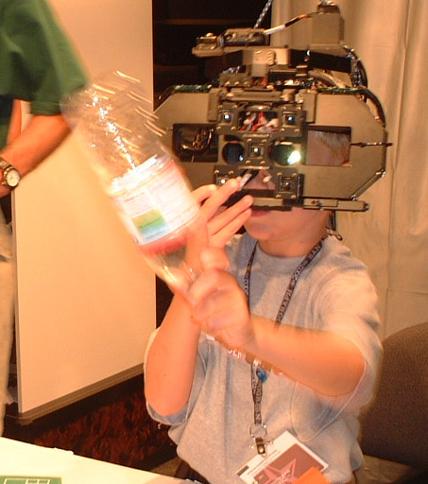
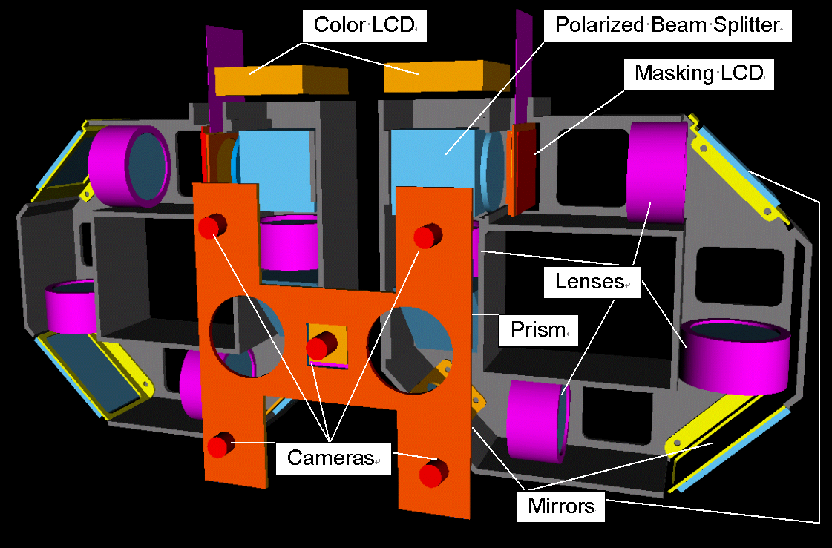
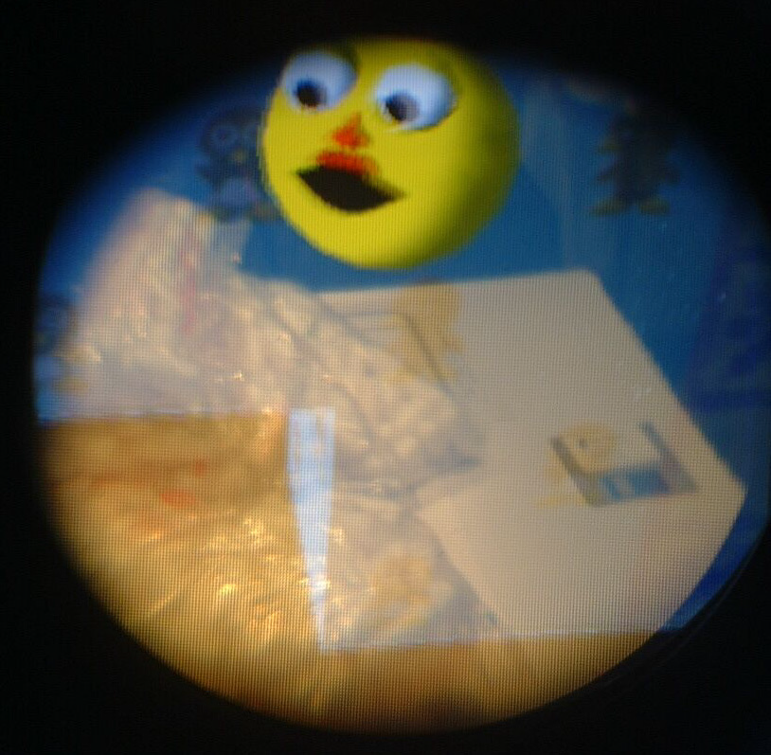
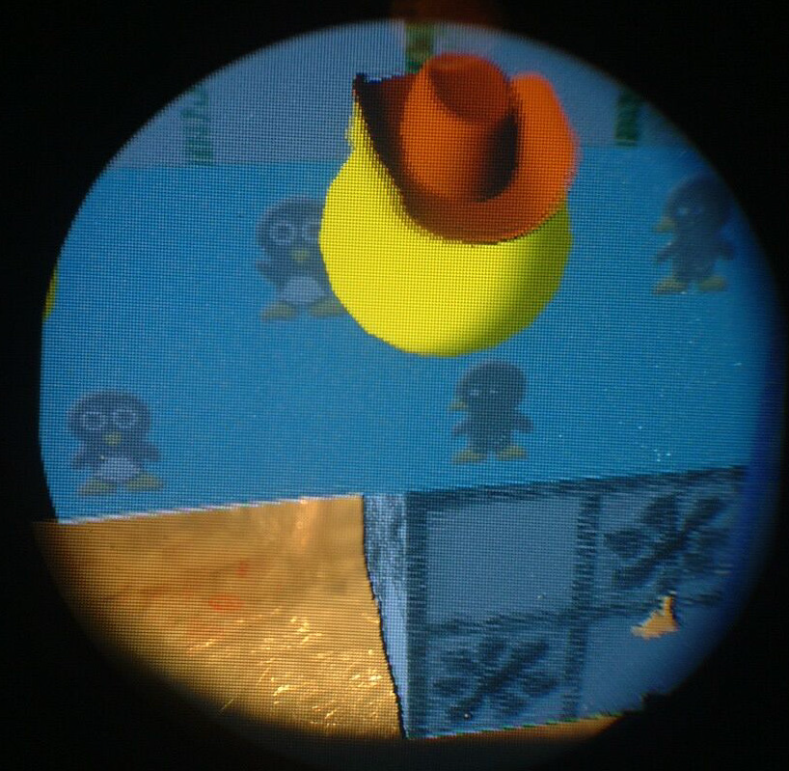
Hardware Based Solution
Kiyokawa et al, An Occlusion-Capable Optical See-through Head Mount Display
for Supporting Co-located Collaboration. ISMAR 2003

Slide 8
How We differ ?
We aim not to change the location of UI elements
or
Add new hardware components
we wanted to manipulate the color shown by the display; an approach known as Color Correction.

Slide 9
Color Correction
Involves in the system finding an alternate digital color which, upon blending with the background comes closer to the desired digital color

Slide 10
Background
To pick a alternate color we need ability to predict how colors blend on a given display.
We propose a new color blending model that can predict how colors blend on a OSTD

Slide 11
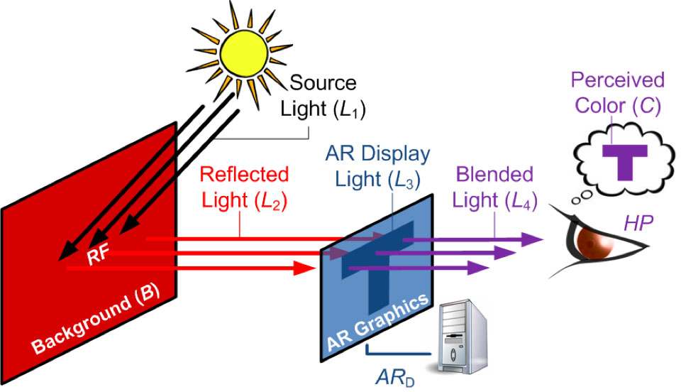
Color Blending
Color blending is the phenomenon where two colors mix to form a third.
Gabbard et al.[2010], studied such color changes in OSTD by building an experimental test-bed
Gabbard et al, More than meets the eye: An engineering study
to empirically examine the blending of real and virtual color
spaces. In Virtual Reality Conference (VR), 2010

Slide 12
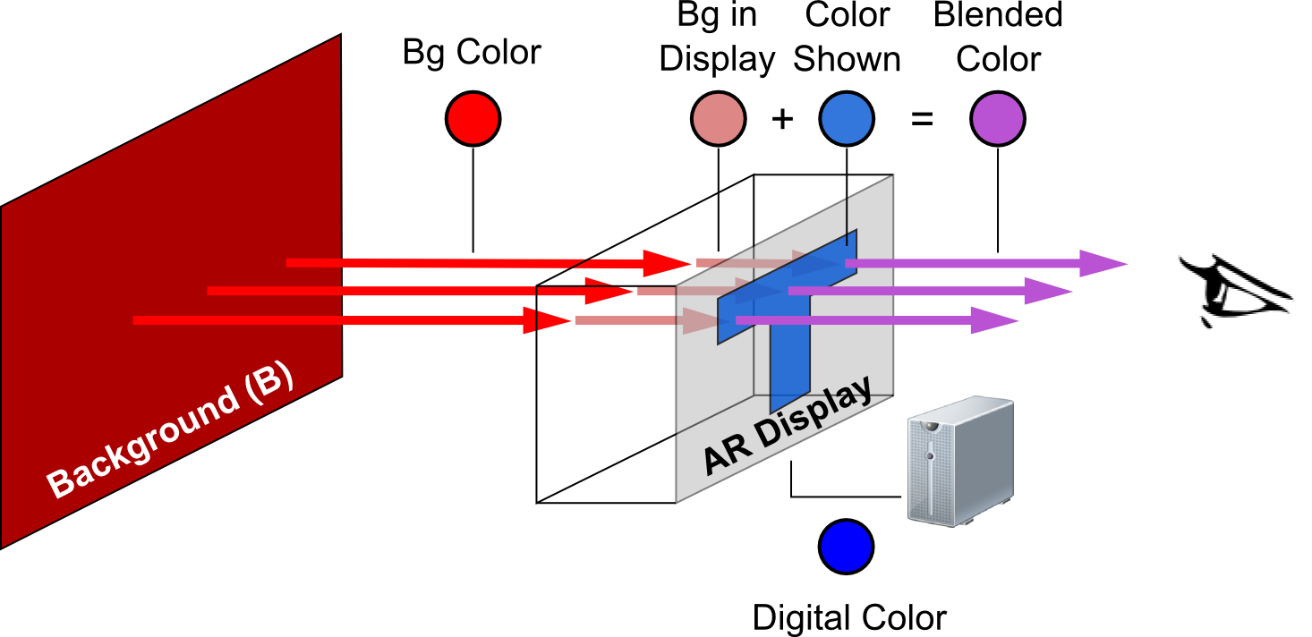
Color Blending Model
We created a new Color Blending model
It is based on Two distortions functions:
Render Distortion
Material Distortion
Blended Color = frender(Digital Color) + fmaterial(Bg Color)

Slide 13
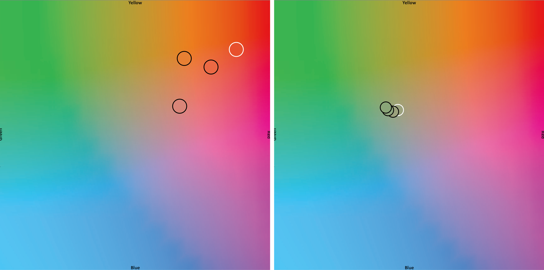
Color Blending Model
Foreground Colors
Background Colors
Render Distortion Function
Material Distortion Function

Slide 14
Contribution
A new Color blending Model for OSTD
Introduce Binned Profile (BP) – To handle Render Distortion
Color Blending Model Based on BP- BP Method
BP Based Color Correction

Slide 15
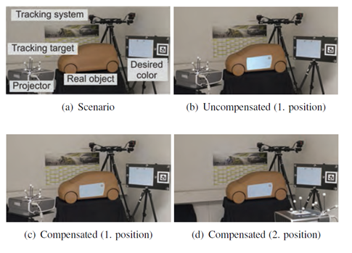
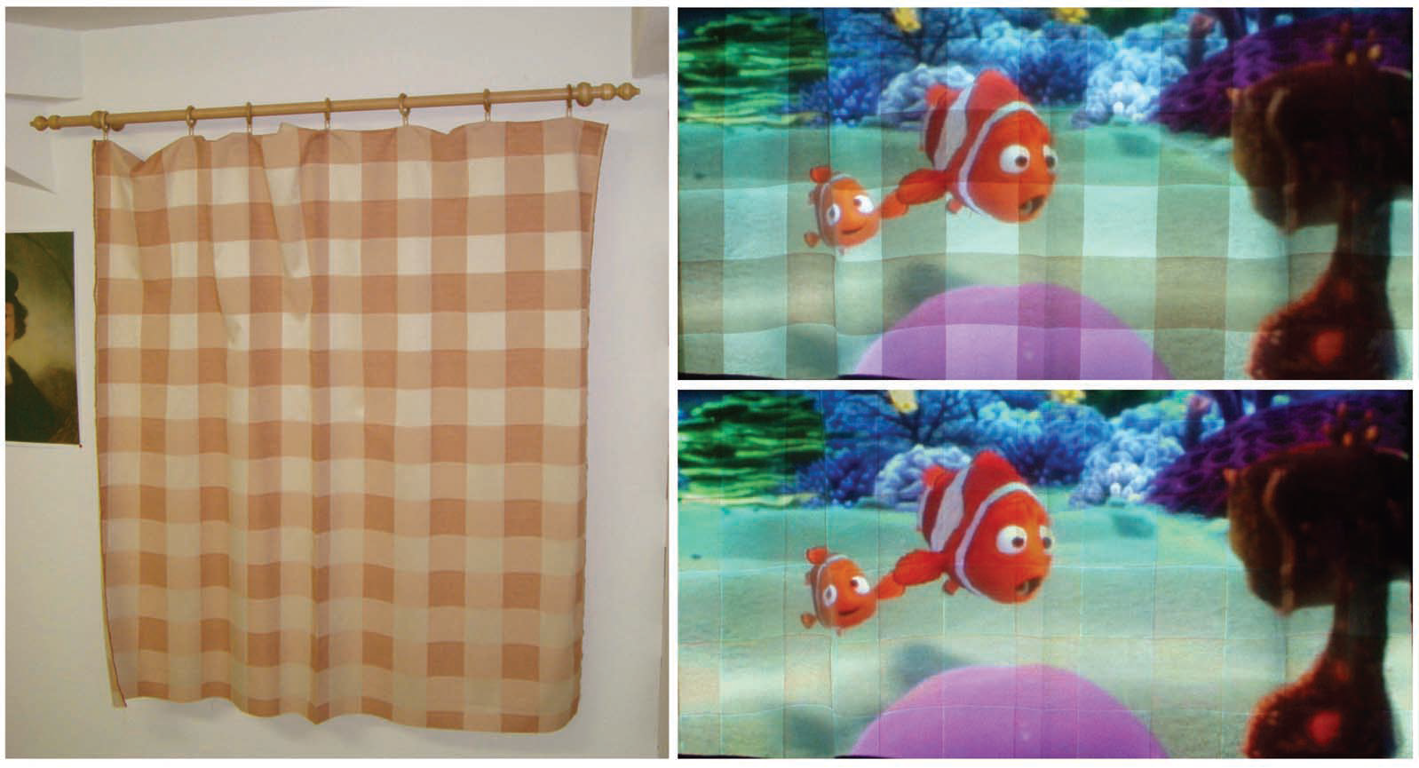
Existing Works on Color Correction
Bimber et al Embedded entertainment with smart projectors.2005
Menk et al, Interactive visualization technique for truthful color reproduction in spatial augmented reality applications. ISMAR 2011
Notes:
Color correction in projector are a close related area which also deals with real world color affecting the digital.
1) This work was the base line for previously shown work by Weiland .
2)Work deals with projecting on to a physical display.

Slide 16
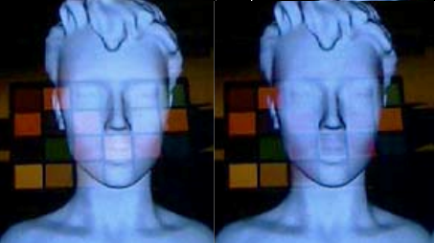
Color Correction in OSTD
Weiland et al, Colorimetric and photometric compensation for optical see-through displays.

Slide 17
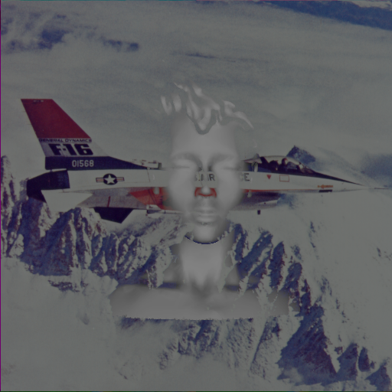
Drawbacks
Their Work Ignores both the distortions
They used sRGB space for color calculations
They used Color Subtraction

Slide 18
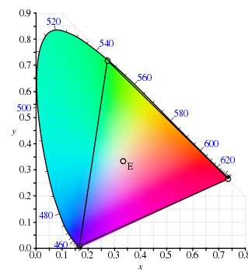
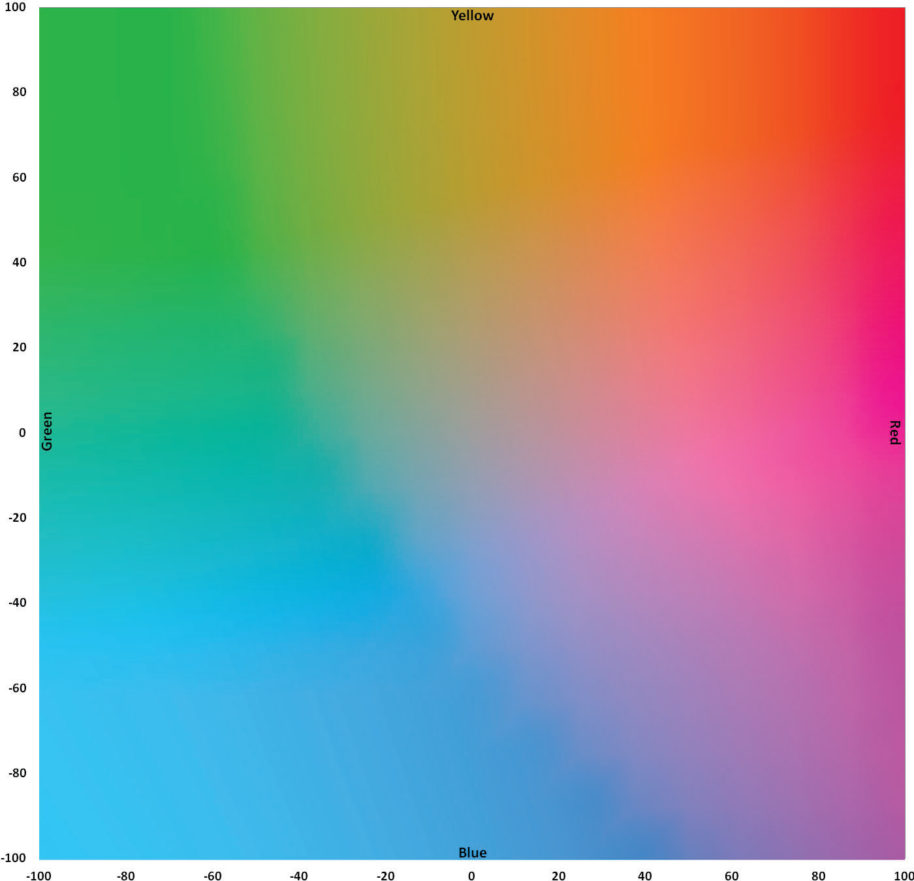
Color Spaces
CIE (International Commission on Illumination)
Basic: XYZ (1936)
Uniform: LAB (1976)
Digital: sRGB

Slide 19
Experimental Test-Bed
Three OSTD were used
2 Projection based
1 T-OLED

Slide 20
Projection based
A view control film called Lumisty(MFY 2555) was used to create the transparent screen
Two different projectors were used:
Epson 1705 with 2200 lumens
Epson VS35ow with 3700 lumens

Slide 21
T-OLED

Slide 22
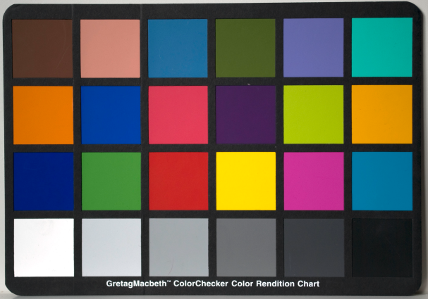
Background colors for experiment
Picture from Wikipedia
23 Macbeth chart colors used as background
Notes:
These are the colors which I will be using in my evaluations

Slide 23
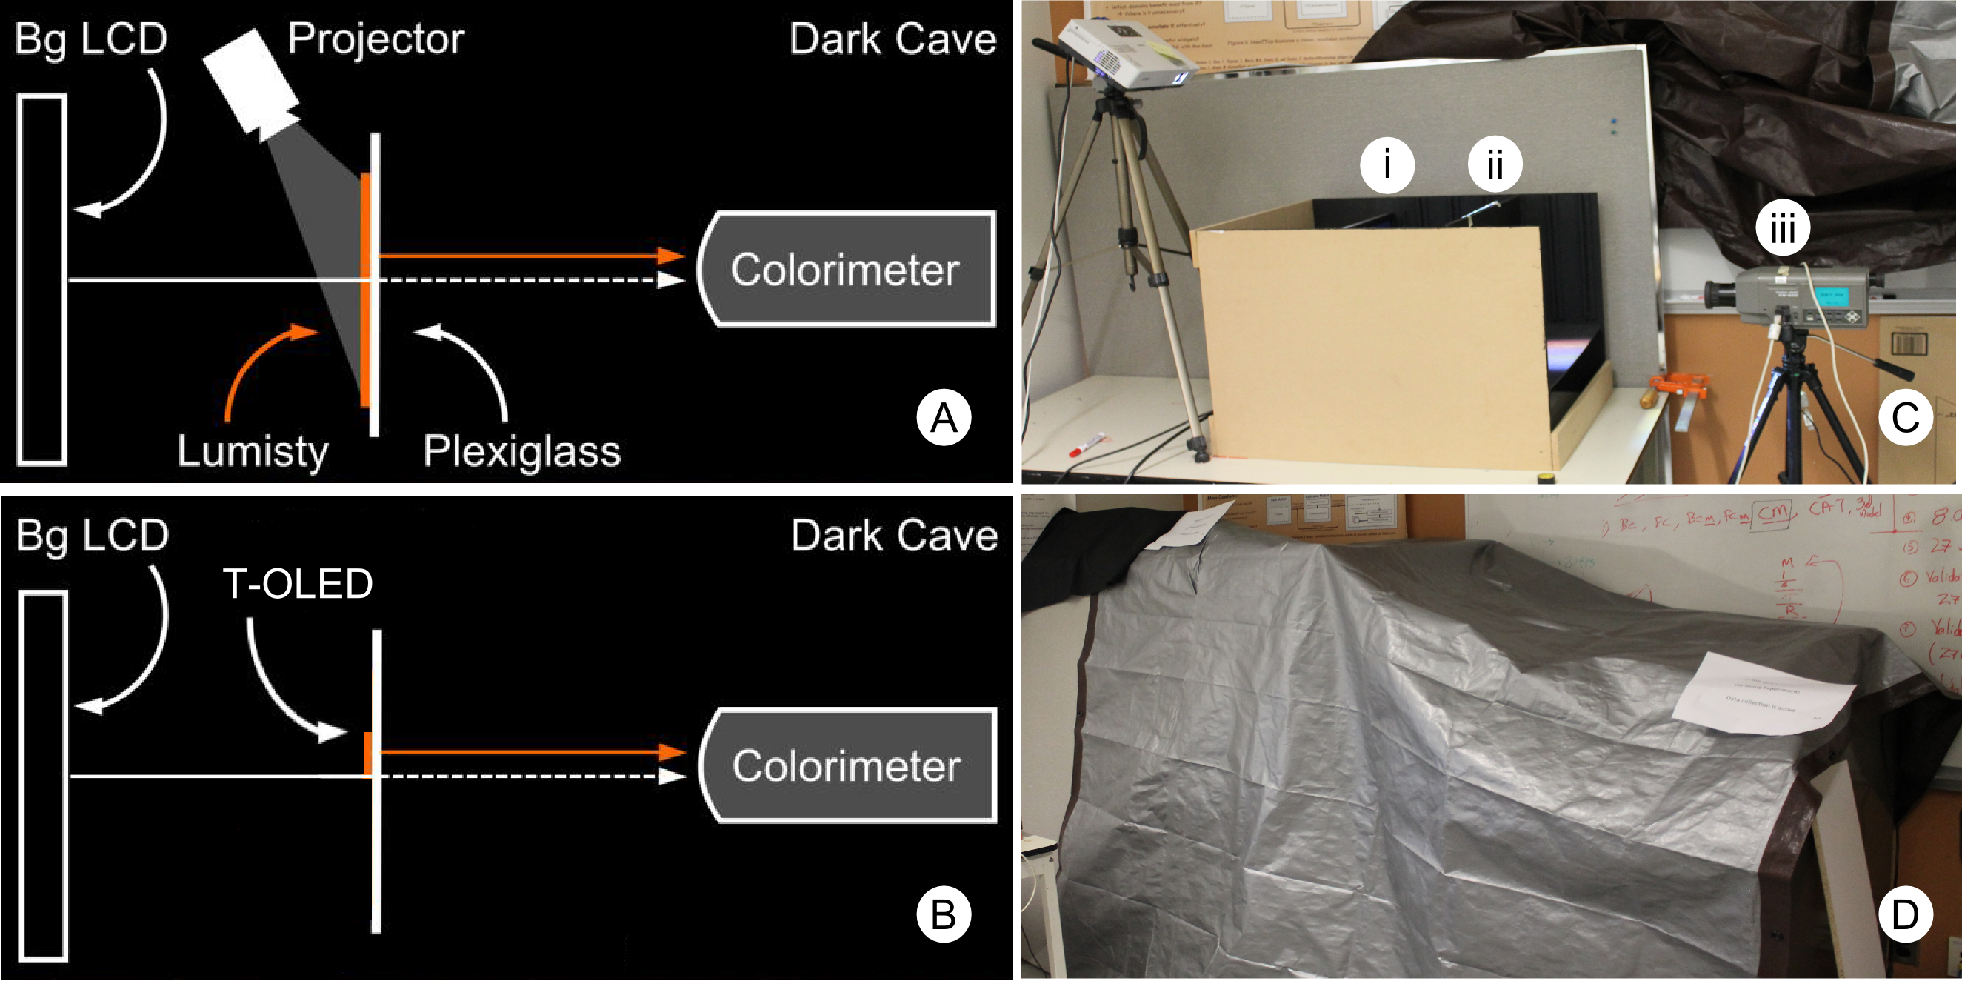
Setup

Slide 24
The Binned Profile
Divides sRGB color space (over 16 million colors) into a smaller set of 8376 perceptually different bins.
We translated the sRGB gamut into the CIE LAB color space and divided it into bins of 5X5X5
This approach guaranties all colors inside a bin are within one Just Noticeable Difference (1 JND ~ 2.3 in Euclidean distance)
we measured how each bin is rendered by each of our three displays on a black background
Create a look up table which is Binned Profile

Slide 25
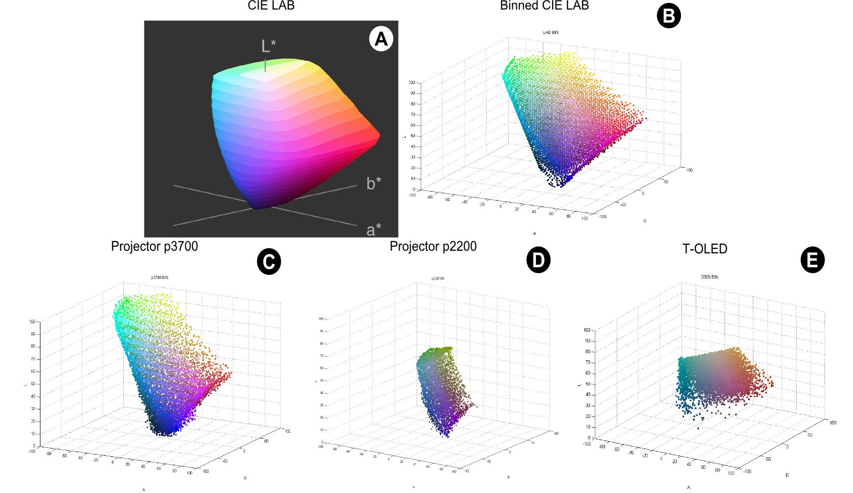
sRGB colors in LAB space
8376 Binned representative sRGB
p3700
p2200
T-OLED

Slide 26
BP Method Color prediction
Binned Profile
Foreground
Measured foreground
Background LCD
Text
Background
Measured foreground in binned profile
Prediction
Notes:
First show that how system wants to show the color
And how its mapped to a custom gamut ,where each color is indexed to its source in sRGB
Once we know what Ci is , we look up in this table where it can give the corresponding RGB in custom space ,
Then on know this and the BG we can find Cp.

Slide 27
Color Prediction Model
We tested the validity of this method against
Direct Method
CAT Method

Slide 28
Direct Method
Synonymous to Weiland et al work
The digital color is simply added to the background
It ignores both render and material distortion
Notes:
Its named Direct model as it provides a direct solution.
Explain as given on the slide !

Slide 29
Direct Color Prediction method
Text
Background
foreground
prediction
Notes:
Explain the slide as per the animation order!!
Ie)
We know the Bg
We know the Ci ( color the computer wants to show)
Add these two colors linearly and give the predicted color mixture!

Slide 30

Chromatic Adaptation Transform (CAT)
CAT are established methods to estimate the colors a display can render based on the brightest white it can emit.
Pictures from Lindbloom website
Notes:
Is a popular method which is provides a transformation matrix to show how a particular color looks in different lighting
As seen in the image.
This can be used to predict how the display will show a particular color

Slide 31
Chromatic Adaptation Transform (CAT)
Bradford
Von Kries
XYZ Scaling

Slide 32
CAT Method
CAT transformed foreground
Foreground
Text
Background
CAT transformed foreground
prediction
Notes:
Explain as per the animation
We know the Bg
We know how Computer wants the show the color
We know it doesn look the same as we want to show
Use cat by knowing the white point of the display to predict how Ci will look in the screen
Use this Cat transformed Ci to add with the Bg to predict the Cp

Slide 33
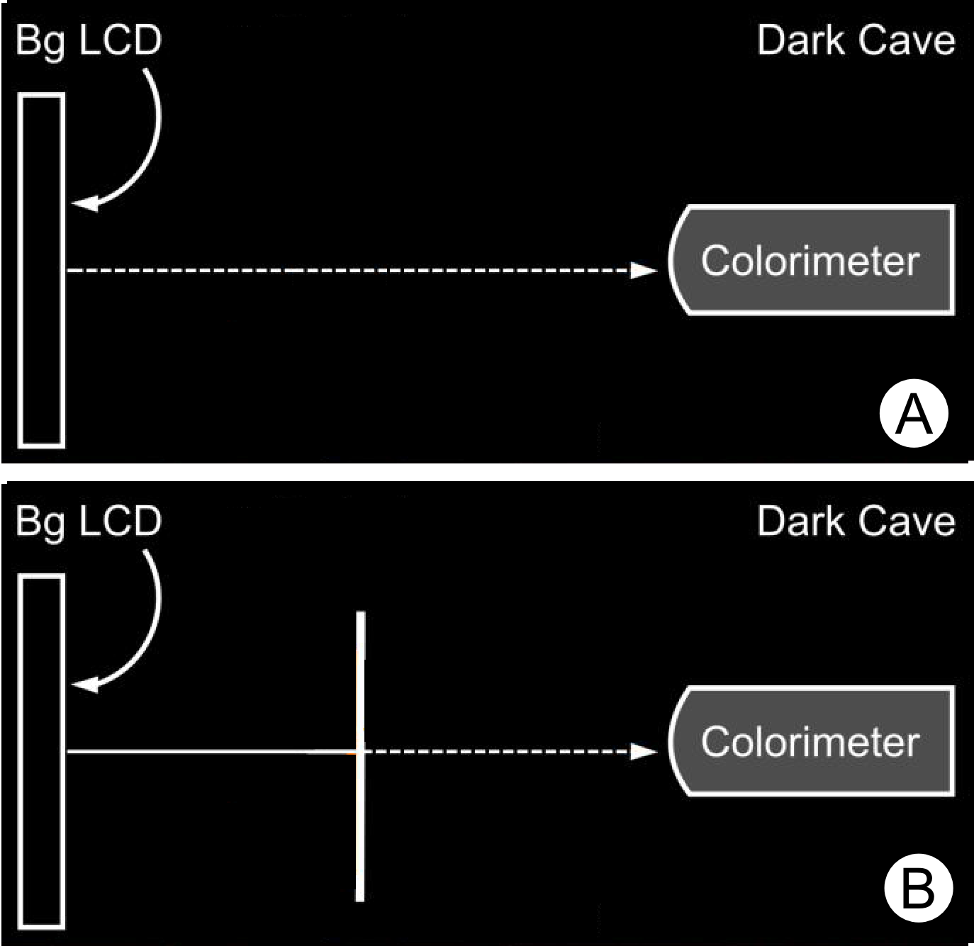
Background Configuration
Plain Configuration
Adjusted Configuration

Slide 34
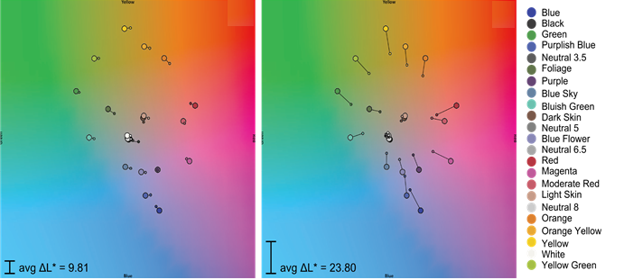
Material Distortion Function
Lumisty
T-OLED

Slide 35
Data Collection
Color blends measured:
23 Bg color , 838 random digital colors
23 X 838 = 19, 274 blend measurements per display
19, 274 X 3 = 57, 822
Color blend predictions :
Display color method (5 methods), background configuration(2 configurations) and display (3 displays)
5 X 2 X 3 X 23X 838 = 578,220.
Euclidean distance in LAB color space between each prediction and the actual measurement gave the prediction error.

Slide 36
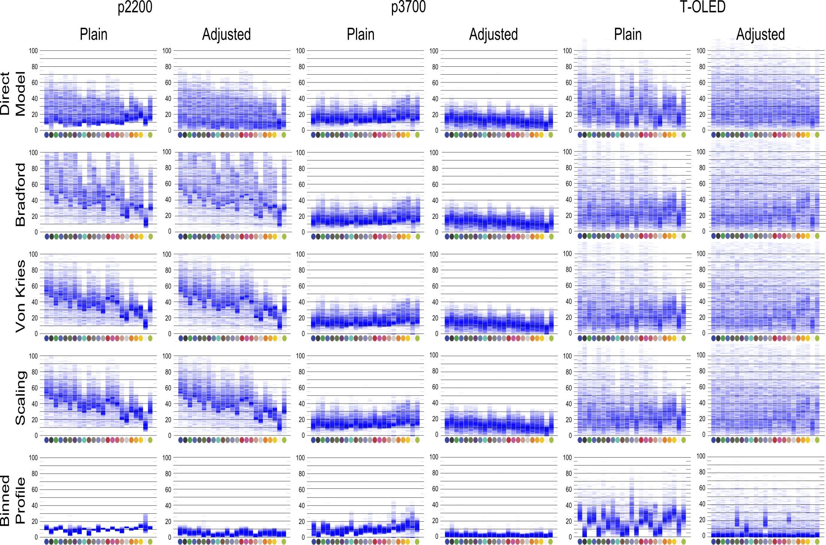
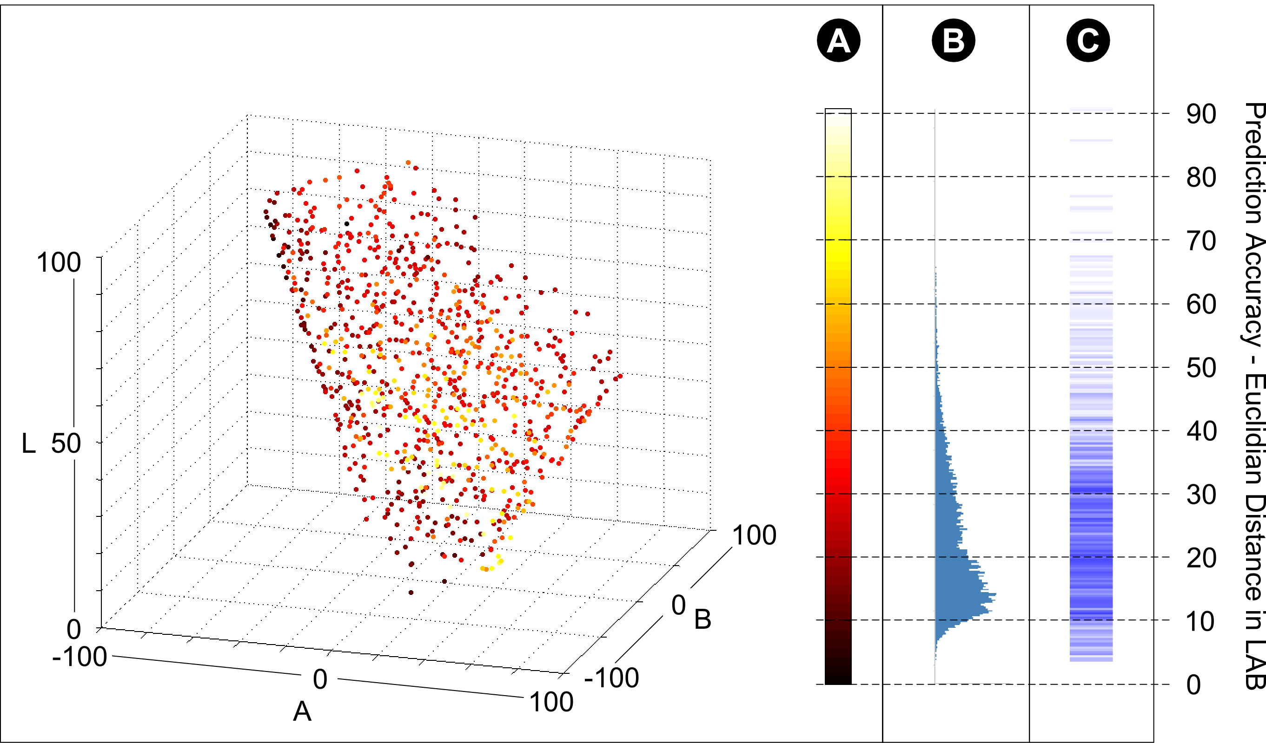
Result

Slide 37
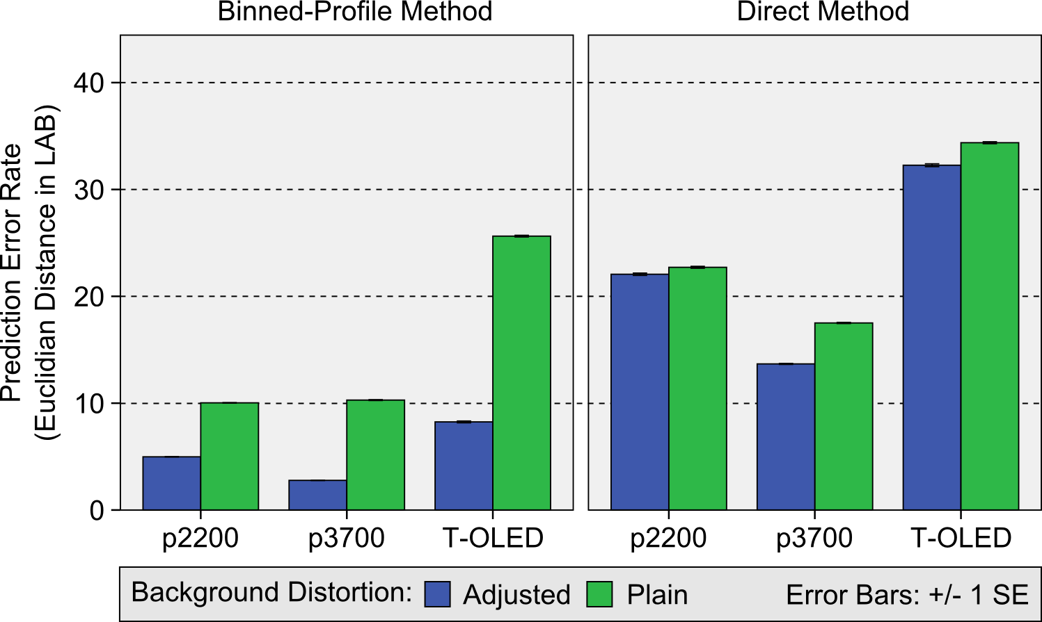
Quantitative analysis
Kruskal-Wallis test was done, Sig <0.0001

Slide 38
Color Correction
We developed a color correction algorithm based on BP method
Input to this algorithm is BP of that OSTD, Desired foreground color, Background Color

Slide 39
Step 1: Foreground Look up
Binned Profile
Foreground
Measured foreground
Desired foreground
Foreground to show
Notes:
First show that how system wants to show the color
And how its mapped to a custom gamut ,where each color is indexed to its source in sRGB
Once we know what Ci is , we look up in this table where it can give the corresponding RGB in custom space ,
Then on know this and the BG we can find Cp.

Slide 40
Step 2: Color Blend Prediction
Binned Profile
Measured foreground
Prediction
Foreground
Adjusted Background
Notes:
First show that how system wants to show the color
And how its mapped to a custom gamut ,where each color is indexed to its source in sRGB
Once we know what Ci is , we look up in this table where it can give the corresponding RGB in custom space ,
Then on know this and the BG we can find Cp.

Slide 41
Step 3:Prediction Comparison
Binned Profile
Measured foreground
Prediction
Foreground
Foreground to show
Difference in LAB
Notes:
First show that how system wants to show the color
And how its mapped to a custom gamut ,where each color is indexed to its source in sRGB
Once we know what Ci is , we look up in this table where it can give the corresponding RGB in custom space ,
Then on know this and the BG we can find Cp.

Slide 42
Data Collection
23 ColorCheck chart’s adjusted backgrounds
200 random display colors for each background
23 X 200X 3 = 13, 800
Euclidean distance in LAB color space between each desired foreground measured and the actual measurement gave the correction error.

Slide 43
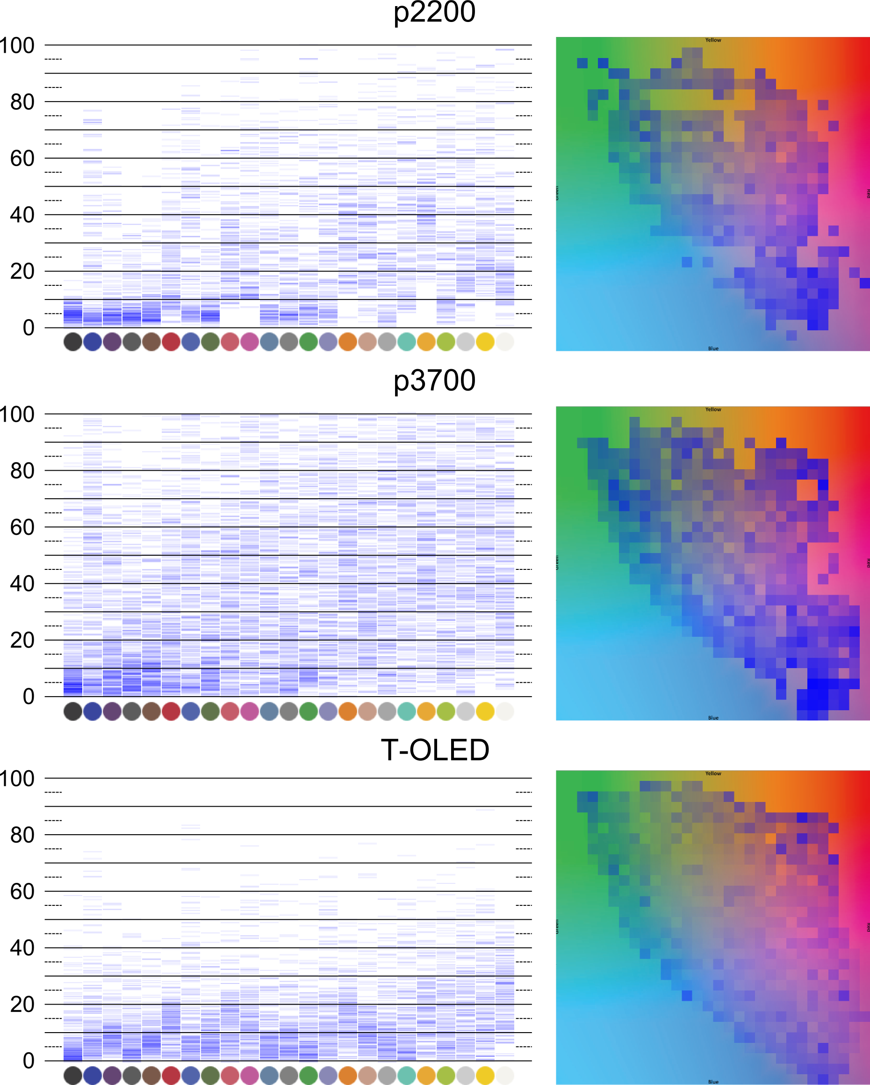
Result

Slide 44
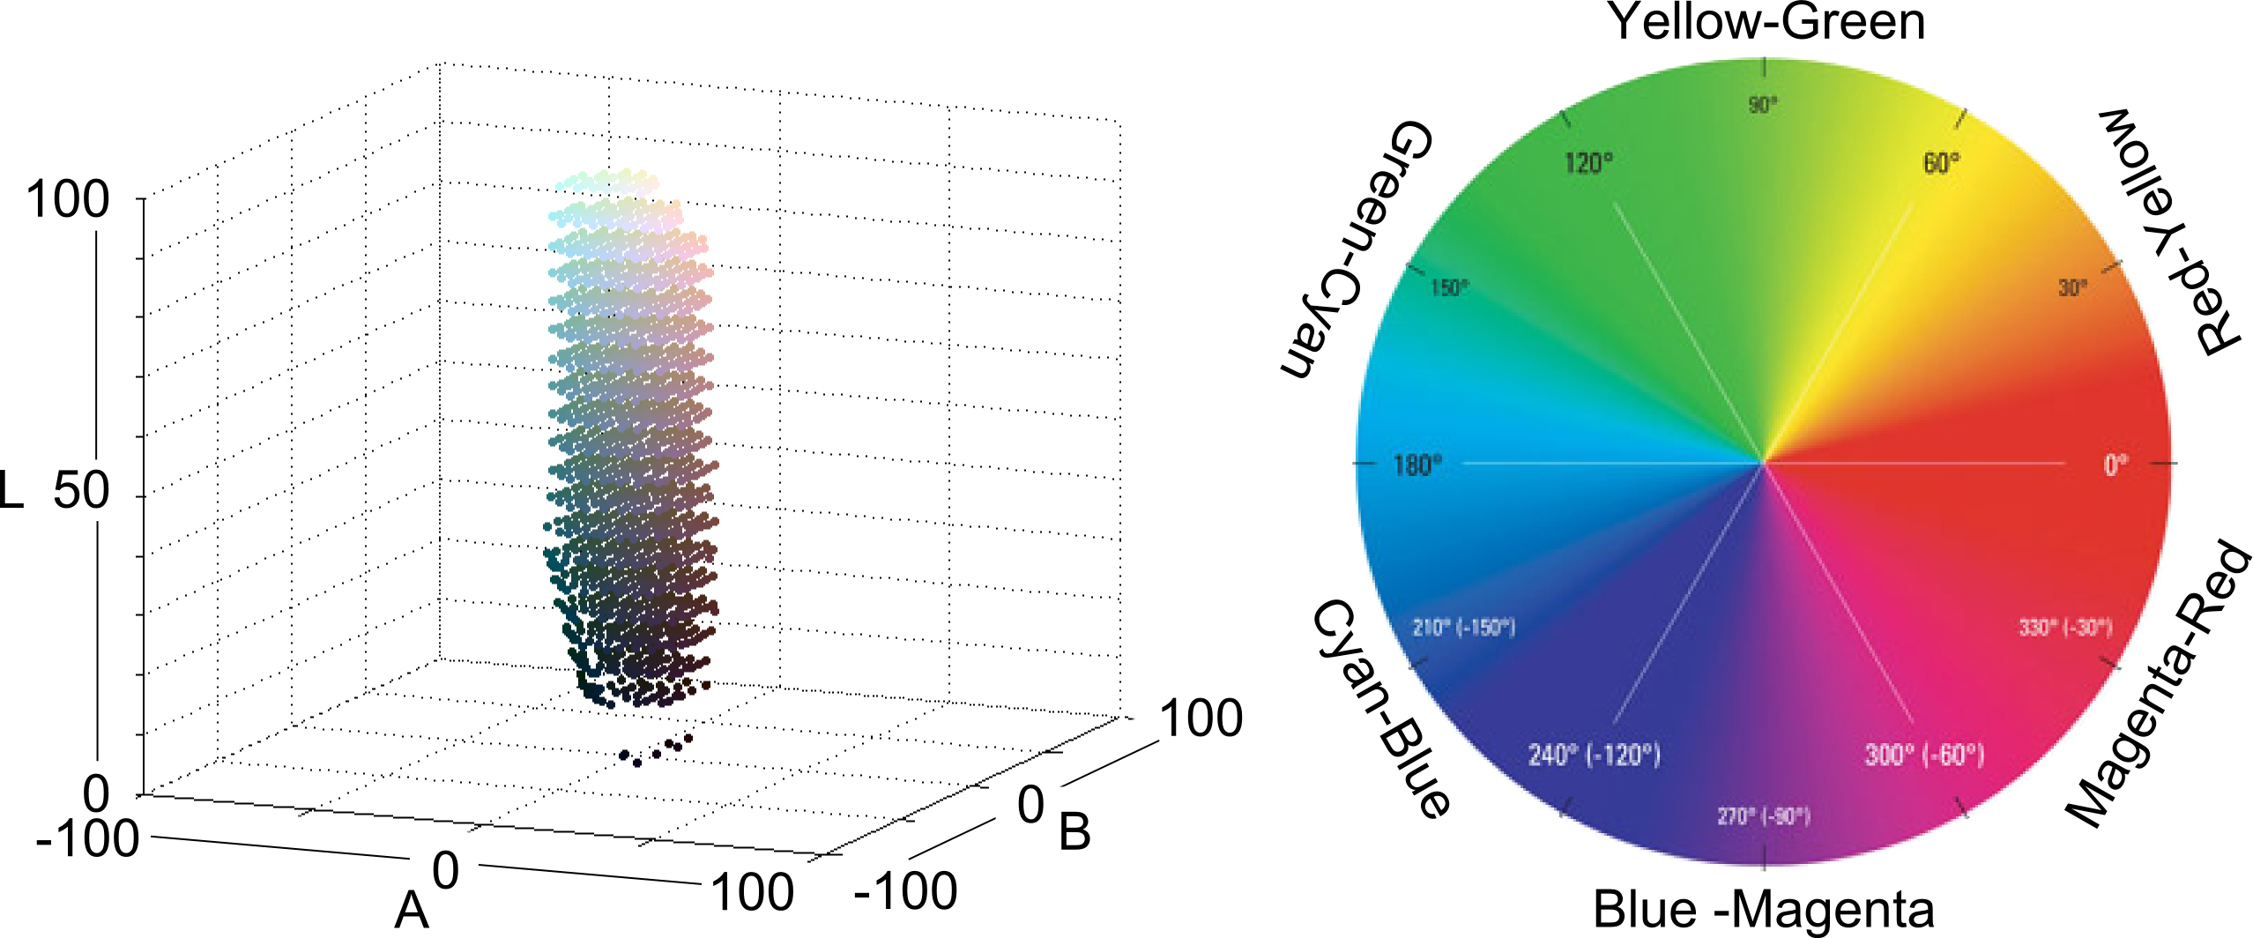
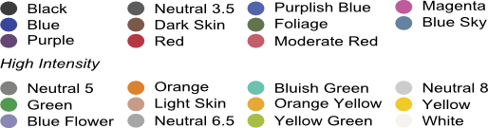
Color Analysis
10 groups:
Dark colors(L < 50), light colors (L >= 50)
Dark and light neutrals
6 chromatic regions
Low Intensity

Slide 45
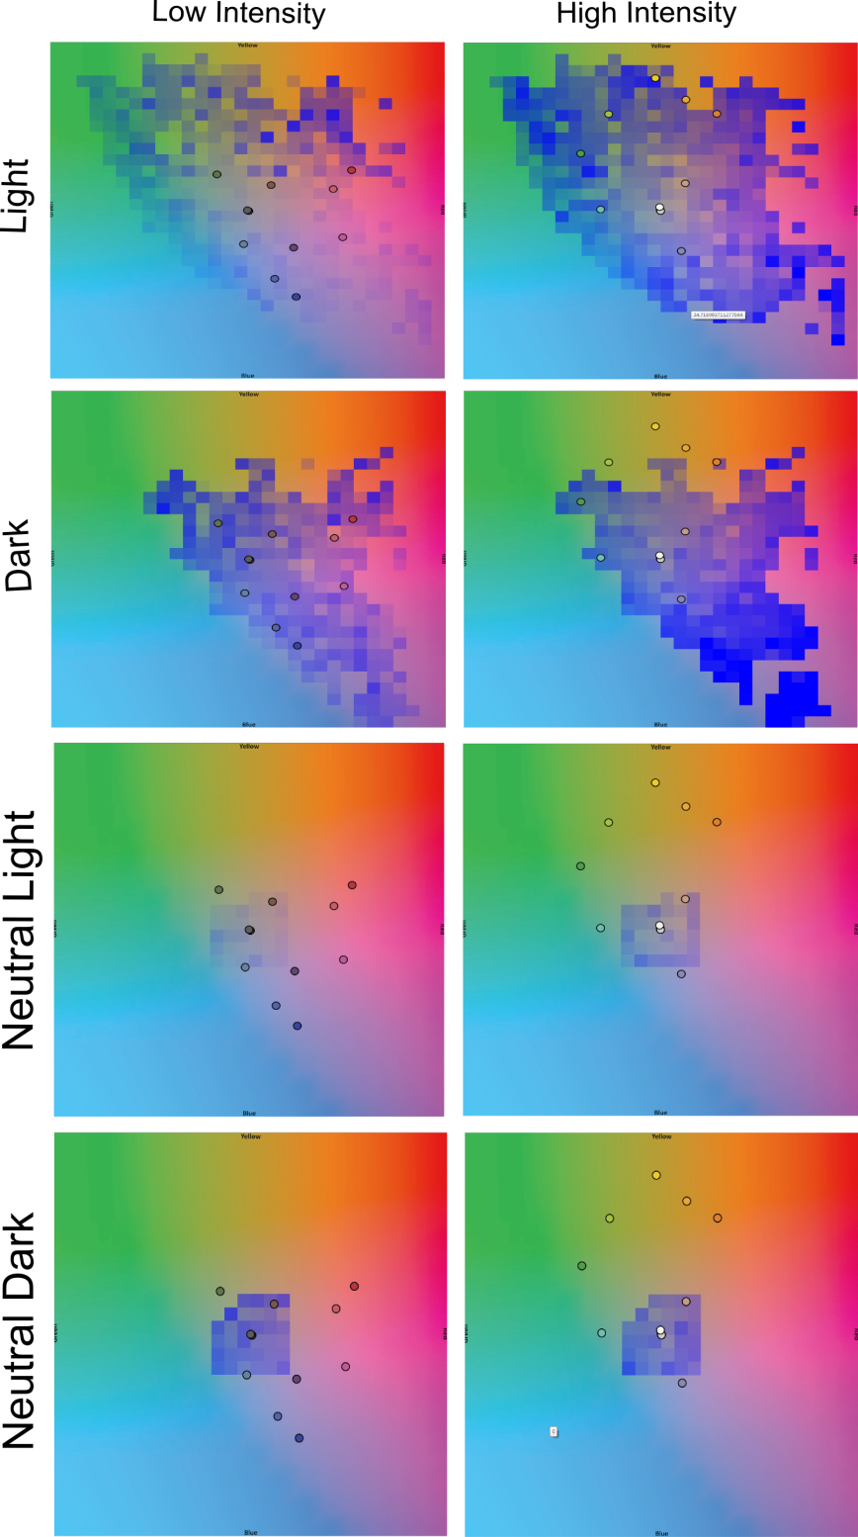

Slide 46
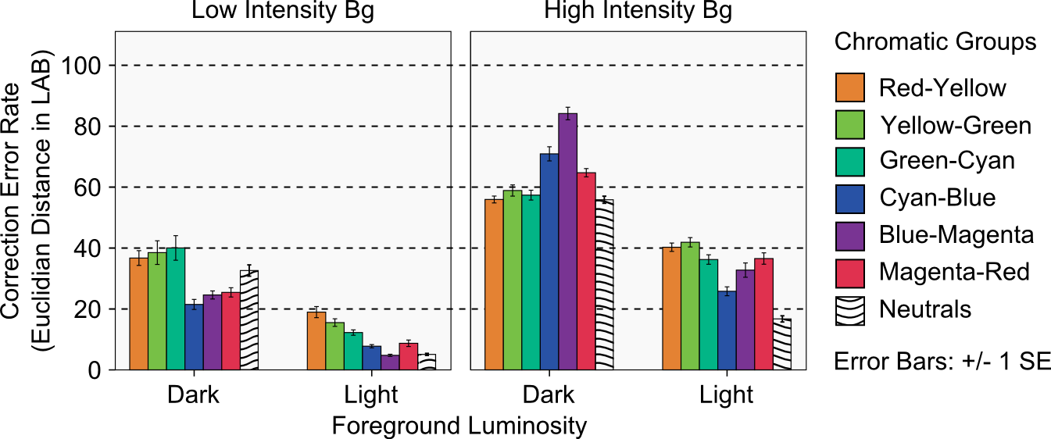
Quantitative Analysis
Kruskal-Wallis test was done, Sig <0.0001

Slide 47
Research Implication

Slide 48
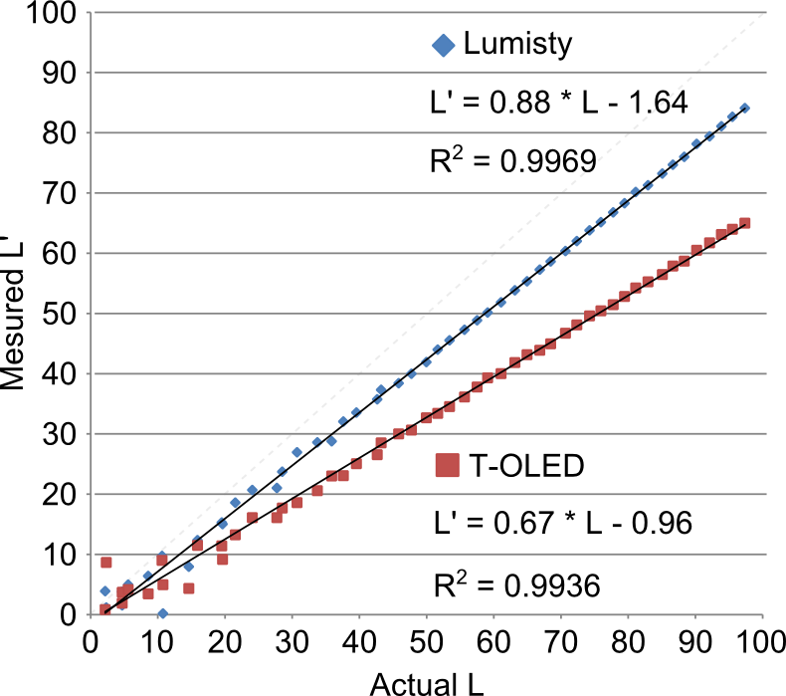
Practical Applicability
Usage of camera to capture the background?
How to capture account for the Material Distortion?

Slide 49
Display Hardware
Is smaller display profile better?
Should the OSTD rescue the intensity of the BG?

Slide 50
Design Implications
light neutral colors for information that needs to be preserved best
If more hue is needed, designers can use light colors in the CyanBlue region
Dark colors should be avoided for text and color-encoded information
Use age of color themes based on the background will be wise

Slide 51
Future Work

Slide 52
Acknowledgements
Dr. Juan David Hincapié-Ramos
Dr. Pourang Irani
Dr. David R. Flatla
Spl thanks to Jango Guo
NSERC and peers at HCI lab In university of Manitoba

Slide 53
Thank you, Questions
Presented by,
Srikanth Kirshnamachari Sridharan

Slide 54
Annexure

Slide 55
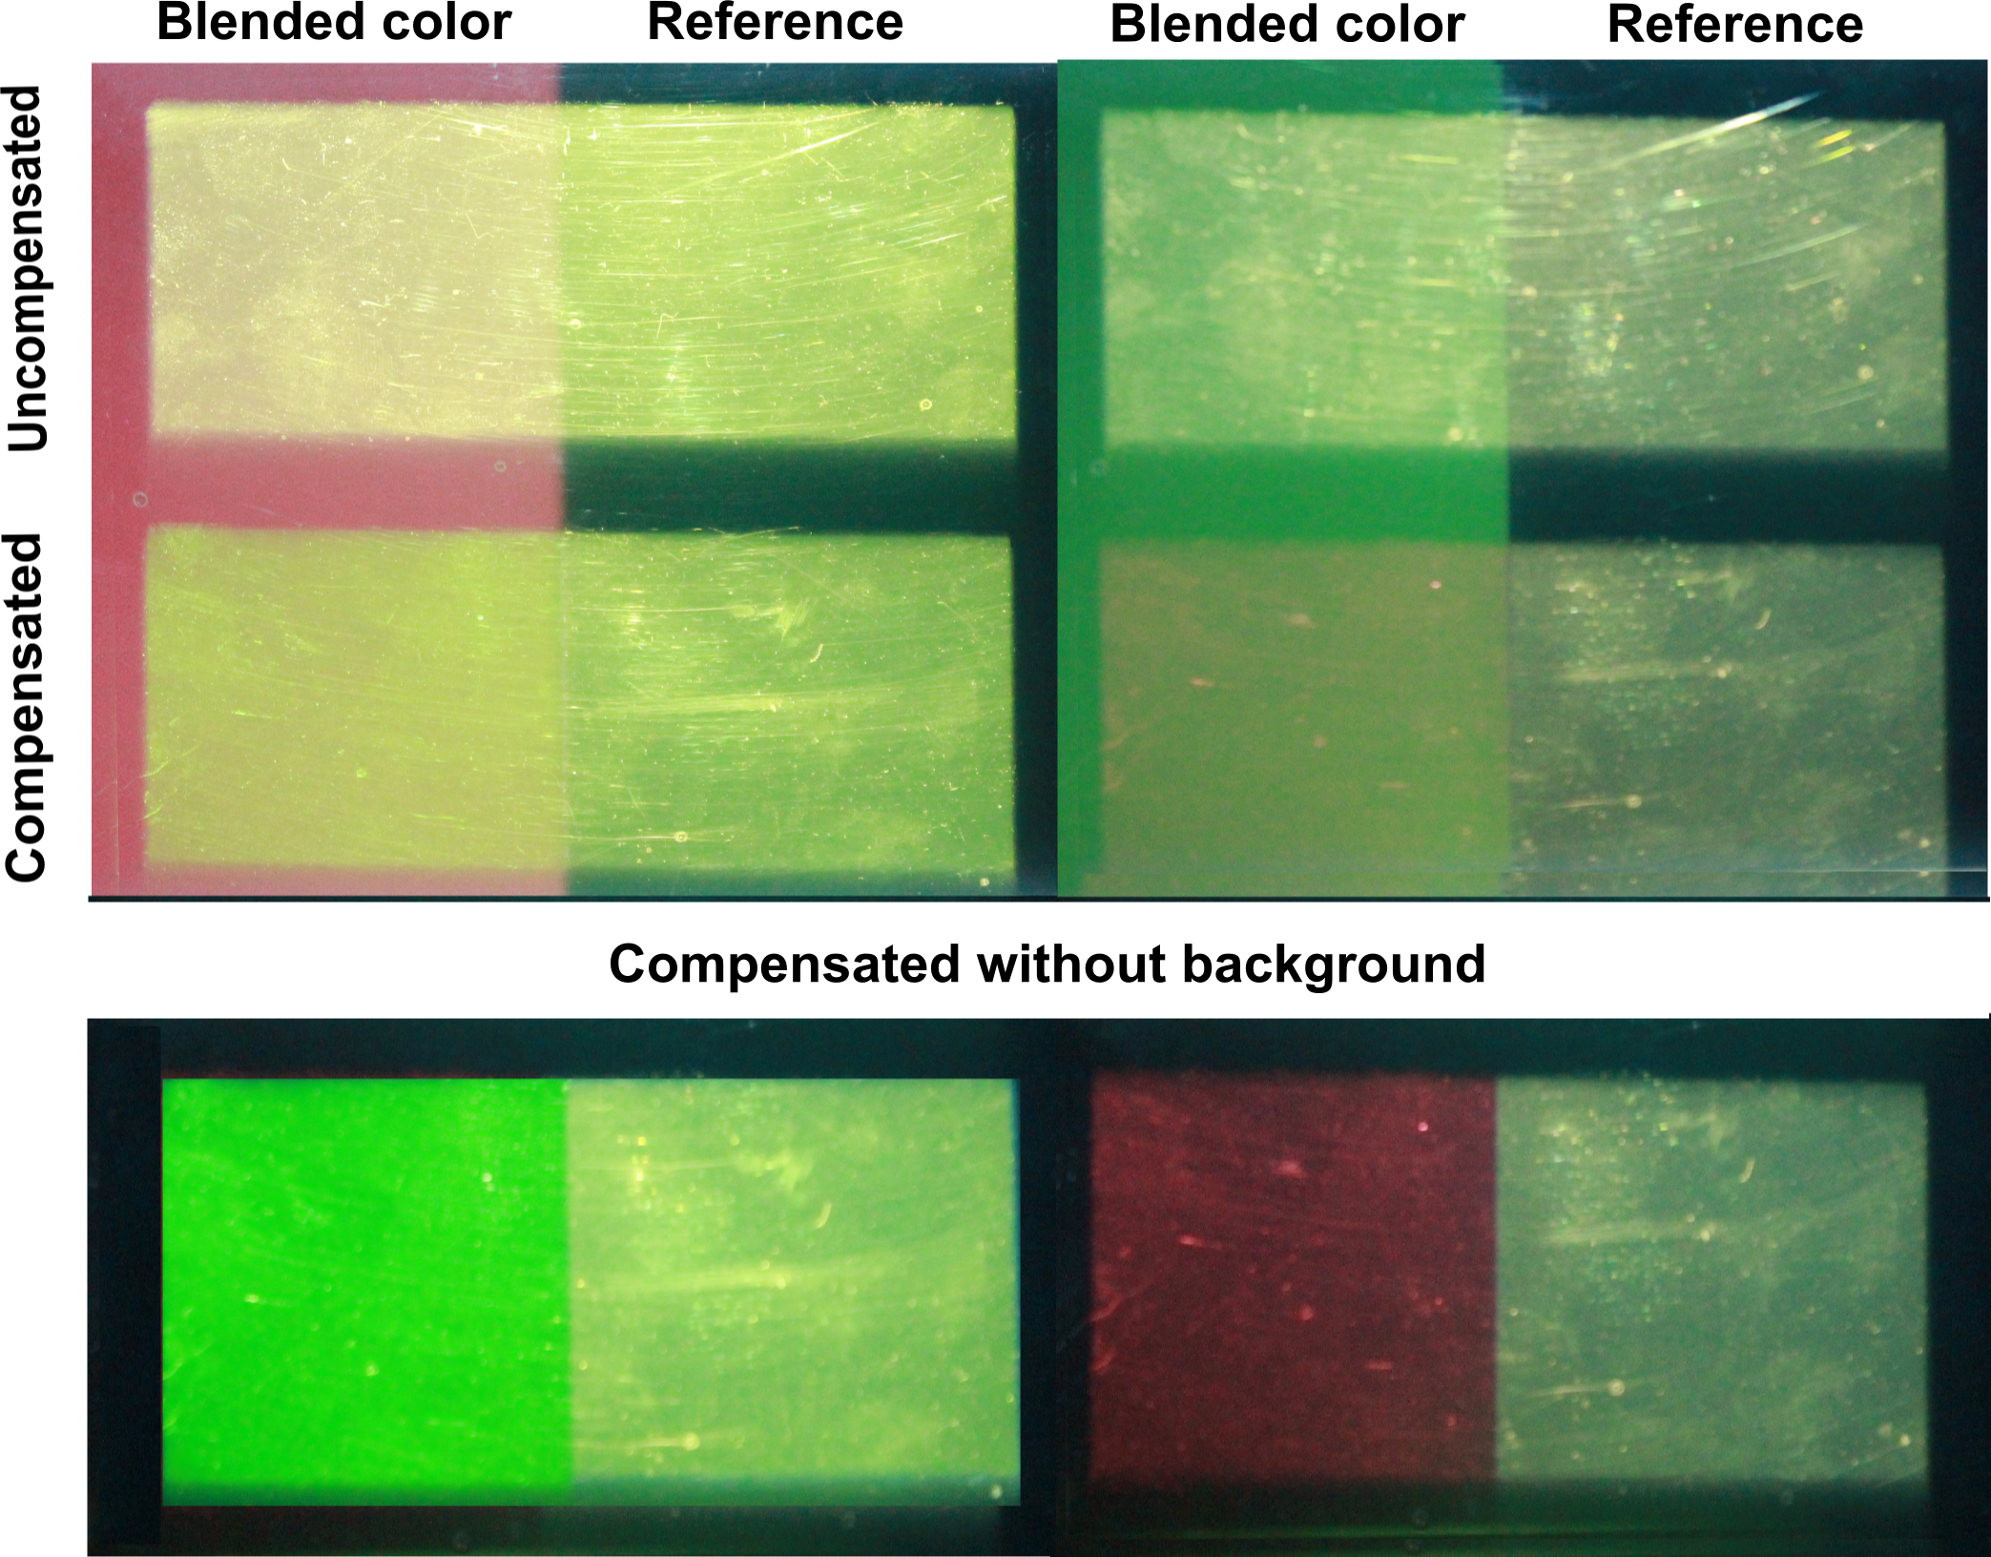

Slide 57
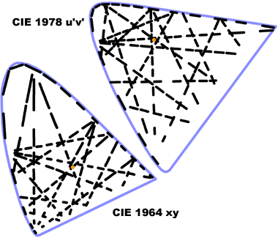
Just Noticeable Difference
Notes:
JND is the Euclidian distance between 2 given color in a color space with in which the colors appear same to humans.
In XYZ space it varies with each color, but in uniform spaces like LAB and LUV its constant number ( 2.5 in lab).

Slide 58
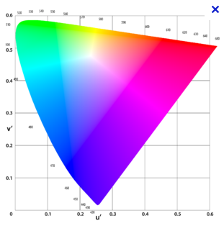
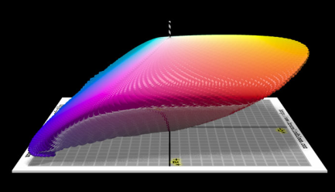
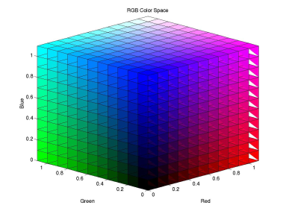
Spaces Derivation
XYZ
LUV
LAB
sRGB
Pictures from Lindbloom’s website and wikipedia
Notes:
Juan , is this slide needed ?? Or just above two is enough??

